Slide 1

Capstone Project Global Terrorism Analysis
By-Ashutosh Pradhan

Slide 2
Content
About Global Terrorism
Data Description
Data Wrangling
Terrorist Activities each year
Number of Total Attack in each Region
Most Targeted city
Attacking Method by Terrorist
Top 10 Affected countries
Terrorist group with highest terror attack
Terrorist Targeted Places
Terrorism activity trend on India
Number of attacks and Causalities by city since 1970
Exploring the most attacked City in India
Top10 terrorist group and attack tactic in India
Terrorist Activities in India Map
Conclusion

Slide 3

About Global Terrorism
Terrorism is a global threat that can take many forms, from lone-wolf attacks to large-scale coordinated campaigns. It is a complex issue that requires a multi-faceted approach to address and prevent it.
Terrorism is a type of violence used to achieve political, religious, or ideological goals, often with the aim of influencing a larger audience. It can take the form of bombings, assassinations, kidnappings, cyberattacks, and other acts of violence. The perpetrators of terrorism often aim to spread fear and instability in societies, and they often target civilians, government buildings, and other symbols of power. The impact of terrorism can be widespread and long-lasting, causing physical and psychological harm to victims, damaging economies, and threatening national security.

Slide 4
Data Description
The Global Terrorism Database (GTD) is an open-source database including information on terrorist attacks around the world from 1970 through 2017. The GTD includes systematic data on domestic as well as international terrorist incidents that have occurred during this time period and now includes more than 180,000 attacks.
Total Rows present in Dataset is 181691
Total Columns present in Dataset is 18
About Columns
Eventid = A 12-digit Event ID system. First 8 numbers – date recorded “yyyymmdd”. Last 4 numbers – sequential
Iyear = This field contains the year in which the incident occurred.
Imonth = This field contains the number of the month in which the incident occurred
Iday = This field contains the numeric day of the month on which the incident occurred.

Slide 5
Country = This field identifies the country or location where the incident occurred.
Region = This field identifies the region code based on 12 regions
City = Name of the city, village, or town in which the incident occurred
Latitude= The latitude of the city in which the event occurred
Longitude = The longitude of the city in which the event occurred.
Attacktype1 = The general method of attack.
Nkill = The number of total confirmed fatalities for the incident
Nwound = The number of total Wounded fatalities in the incident
Targtype1 = All Targeted place name
Summary =
Gname = The name of the group that carried out the attack
weaptype1_txt = General type of weapon used in the incident
Motive = [null]72% Unknown8% Other (35672)20%

Slide 6
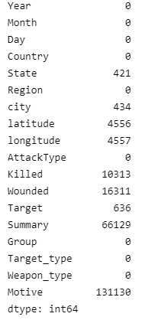
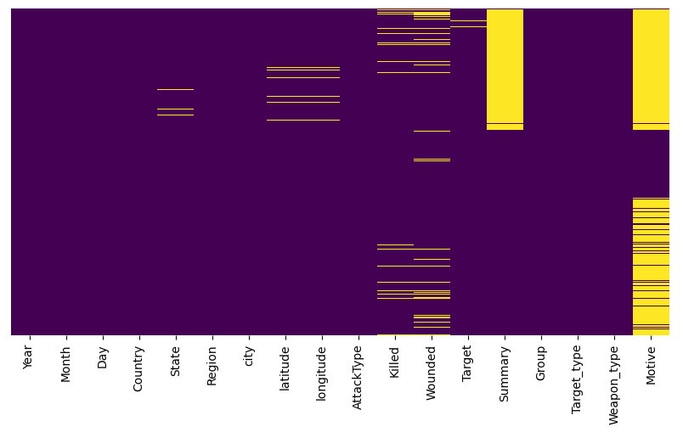
Data Wrangling
Null Values
Heat map of Null Values

Slide 7
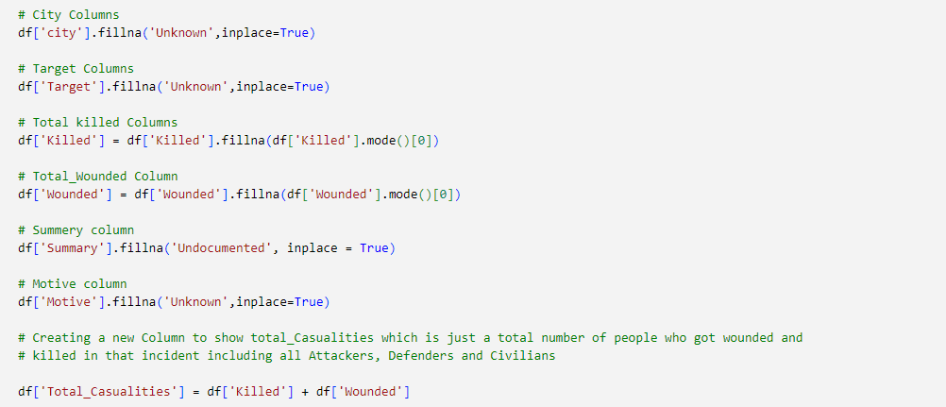
Filling out the missing values
Above we can see that most of the important column contains a lot of NaN or missing values Thus to make a sense out of all that we will start re-placing those values with 'UNKNOWN' value to make it is when we visualize the data via Plots and Graphs. Also You can’t ignore missing data because many algorithms will not accept missing values.

Slide 8
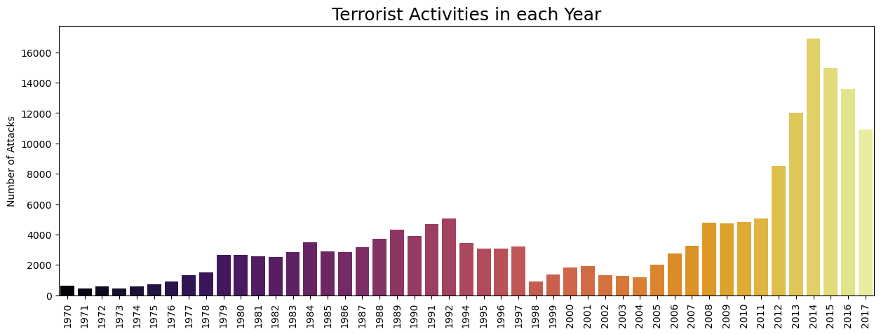
Terrorist Activities each year
Attacks were more during 2014 and then in 2015. When compared to attacks from 1970 onwards, the last 6 years scored a maximum. But from 2014 onwards count started decreasing.

Slide 9
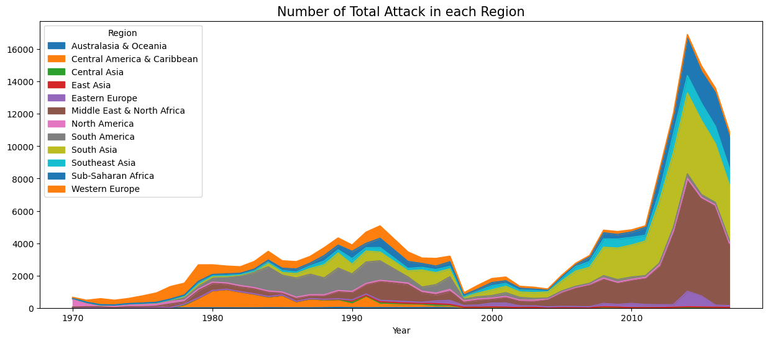
Number of Total Attack in each Region
The Middle East& North Africa leads 1st among all the regions and then South Asia takes 2nd place.

Slide 10
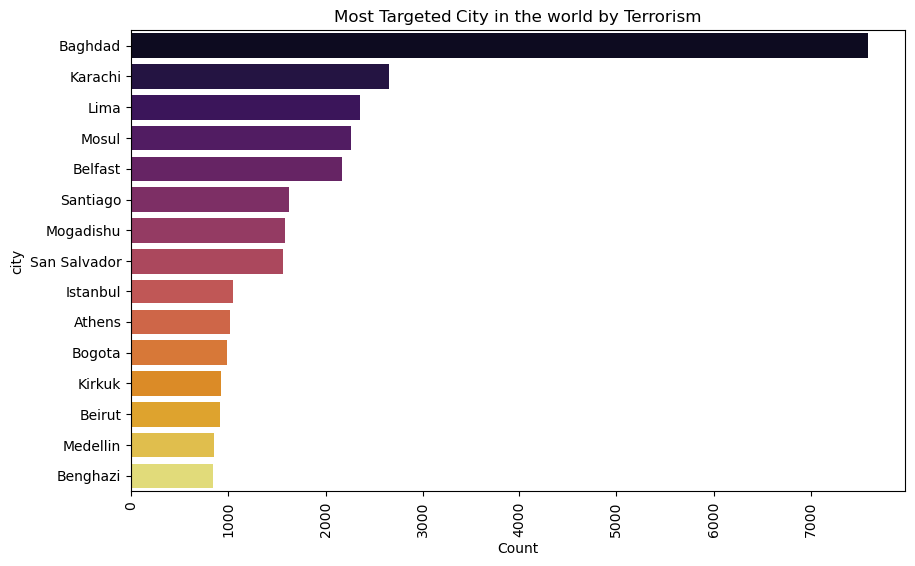
Most Targeted Cities

Slide 11
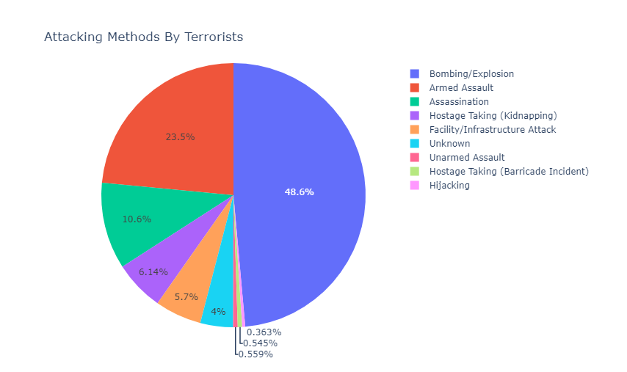
Attacking Method by Terrorist
Most of the attacks were through either Bombing or Explosion.

Slide 12
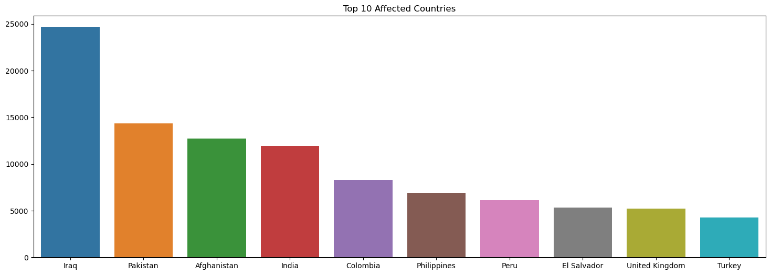
Top 10 Affected countries
Iraq dominates all the countries and it has the highest number of attacks and then Pakistan, Afghanistan, and India follow it. Government should increase safety measures in these countries.

Slide 13
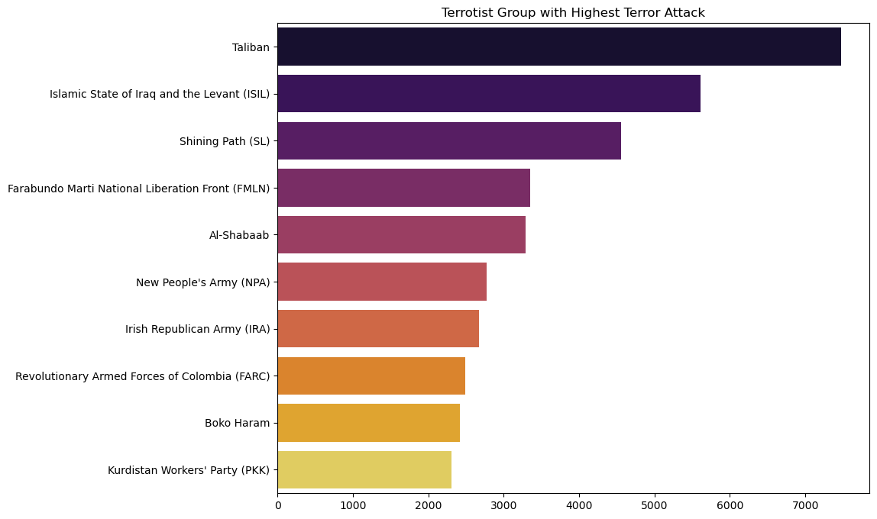
Terrorist Group with Highest Terror Attack
On the above chart number of terror attacks done by a group since 1970, 'Taliban' tops the chart with more attacks. while 'Islamic State of Iraq & the Levant (ISIL)' hold the second place

Slide 14
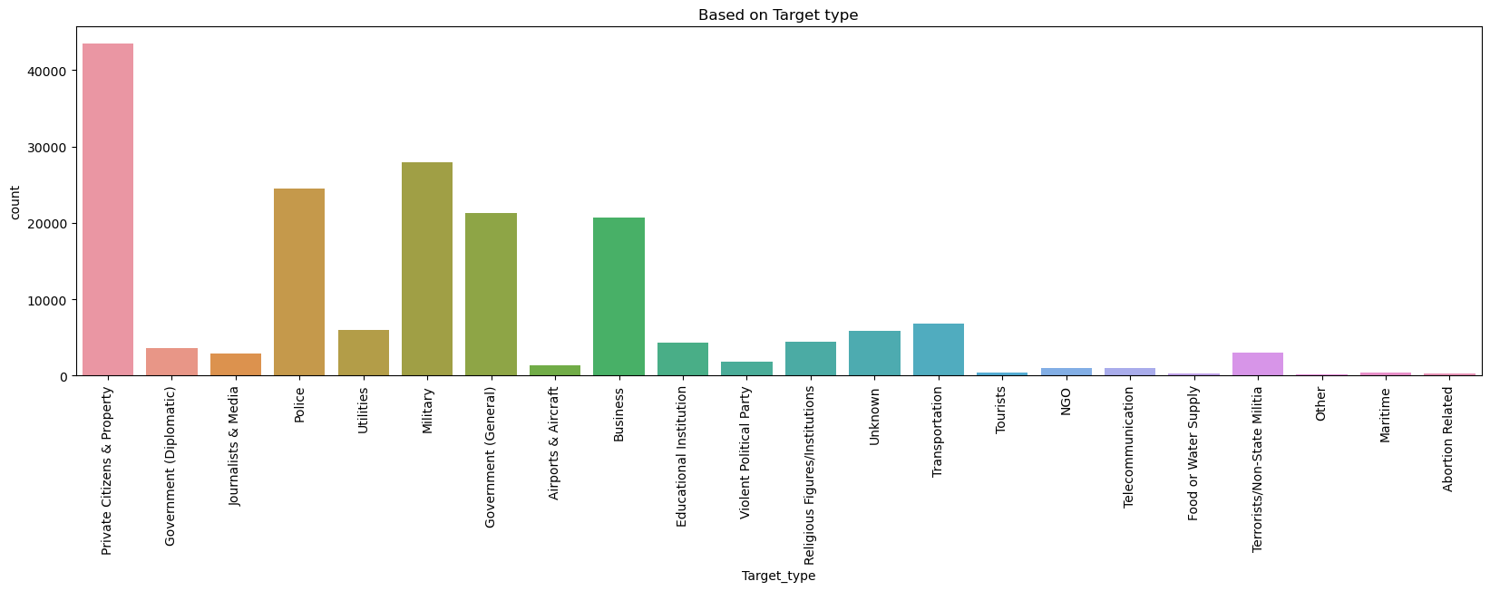
Terrorist Targeted Places
For most of the attacks, the target is Private Citizens& property and the next Military leads.

Slide 15
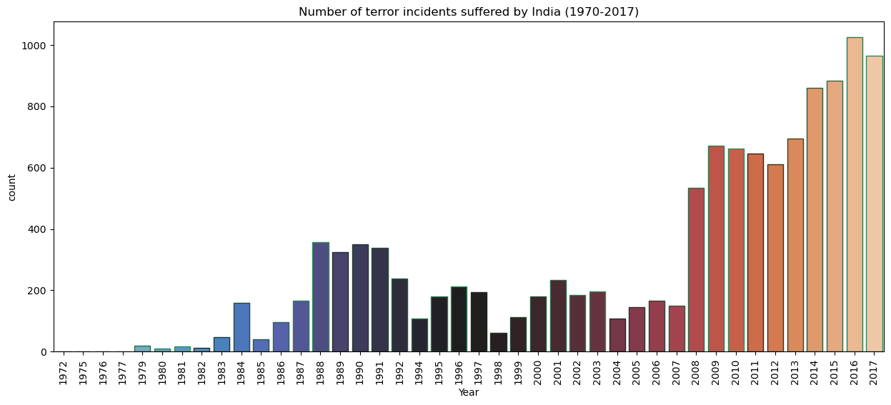
Terrorism activity trend on India

Slide 16
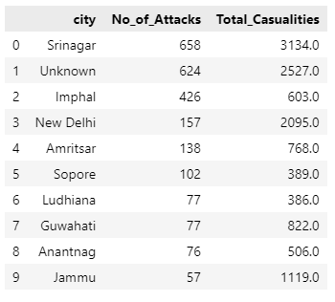

Number of attacks and Causalities by city since 1970

Slide 17
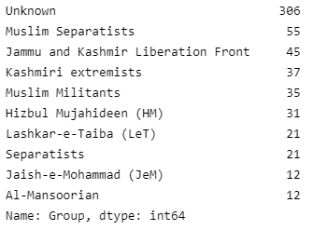
Exploring the most attacked City in India
Since 1972, Srinagar which is in Jammu and Kashmir has been the center of the dispute and terror attacks in India. Srinagar has been under attacks record 658 times on which 3134 people have lost there lives. Almost half of those number of attacks has been done by Unknown groups. On the second place, Srinagar has been terrorized 55 times by 'Muslim Separatists' and 45 times by 'Jammu and Kashmir Liberation Front'.

Slide 18
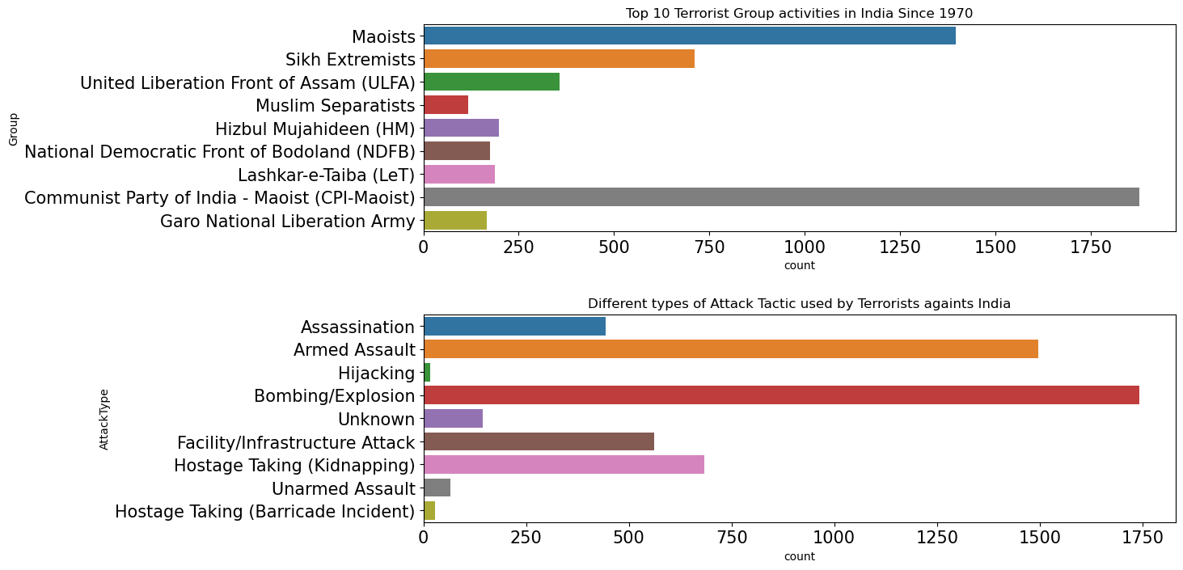
Top10 terrorist group and attack tactic in India

Slide 19
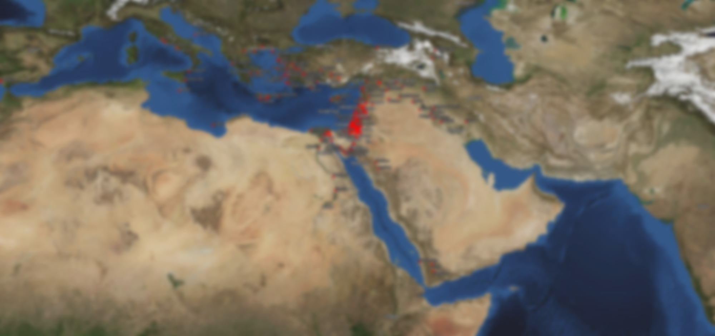
Terrorist Attack on Five Main Continent on Map Visualization

Slide 20
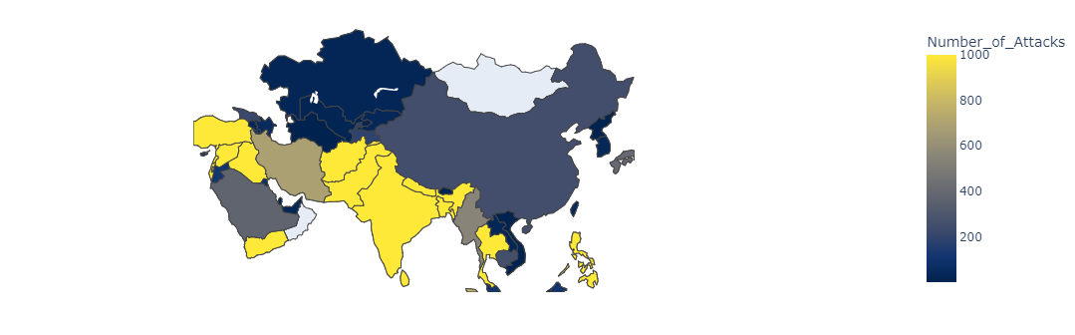
Terrorist Attack on Asia
The Most of Causality happened in western part of Asia like Turkey, Syria, Iraq, Yemen in these Countries most Terrorist Attacked country is Iraq After that Southest part of Asia Terrorist Attack suffered Country like Afghanistan , Pakistan , India ,Bangladesh, Thailand, Philippines in these Countries most Terrorist attacked country is Pakistan and the other side Iran, Saudi-Arabia, Myanmar, Indonesia these countries got less number of Terrorist Attacked .

Slide 21
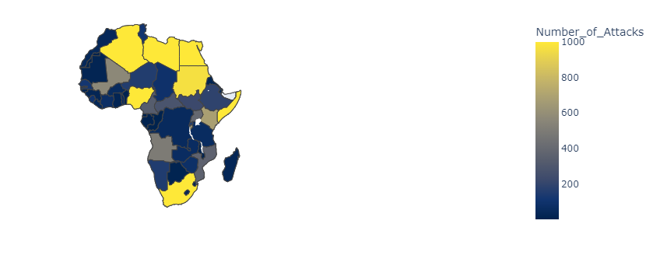
Terrorist Attack on Africa
Northern boarder countries like Algeria, Libya ,Egypt, Sudan of Africa got more casualty. In the Eastern Countries Somalia is most Terrorist attacked countries in Africa and the western country Nigeria and Southern Country South Africa Also Heavily attacked by terrorist.

Slide 22
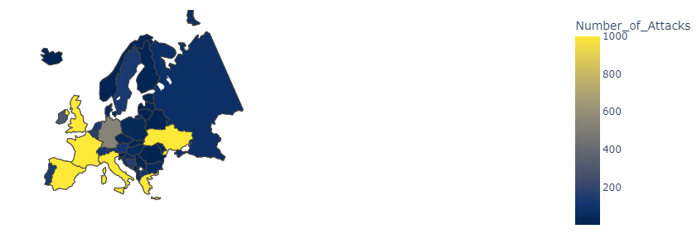
Terrorist Attacks in Europe
Western Europe Countries like United Kingdom, France, Spain, Italy, Greece got more Terrorist Casualties northern part of Europe Ukraine is also Terrorist attacked Country in Europe continent. For business point of view Eastern and northern part of Europe Continent are good for Business .

Slide 23
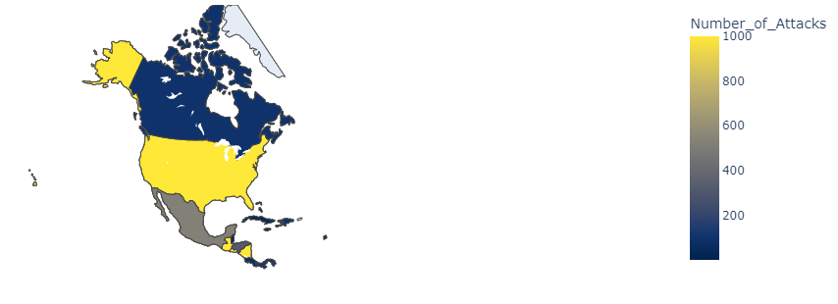
Terrorist Attacks in North America
In Northern America United State and Guatemala , Nicaragua got More Terrorist Causality. After this Mexico got less number of Terrorist attacked in Country and the safest country in North America is Canada and The highest one is United State.

Slide 24
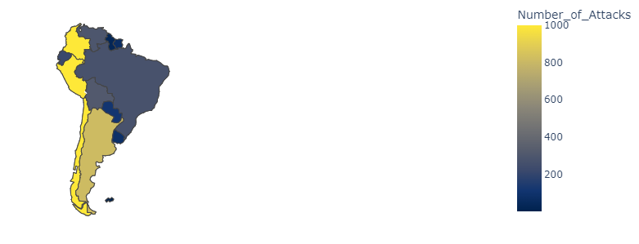
Terrorist Attacks in South America
In the South America Western boarder is most Terrorist Attacked Country like Colombia, Peru, Chile and Argentina got less attacked by Terrorist and The Most Terrorist Attacked Country is Colombia.

Slide 25
Conclusion
Iraq – the country has faced staggering 24636 number of such attacks between 1970 to 2017 which accounted for 13.61% of terrorism attacks in the world.
Attacks were more during 2014 and then in 2015. When compared to attacks from 1970 onwards, the last 6 years scored a maximum. But from 2014 onwards count started decreasing.
Iraq dominates all the countries and it has the highest number of attacks and then Pakistan, Afghanistan, and India follow it.
Middle East and North Africa and South Asia are the two regions who got more terror attacks since 1970
For most of the attacks, The target is Private Citizens & property and the next is on Military leads.
Most of the attacks were through either Bombing or Explosion.
'Islamic State of Iraq and the Levant (ISIL)' were on a killing spread where they murdered 31,058 personal since 1970, Most on compared to other groups. Taliban is again on second place with 29,269 kills.
'Islamic State of Iraq & the Levant (ISIL)' and 'Taliban' are two most active Terrorist groups in the last 5 years.
Srinagar which is in Jammu and Kashmir has been the center of the dispute and terror attacks in India.
Seems like Terrorist do like 'Explosives' very much like this is the most used Weapon category across the world terror groups.

